Slide 1
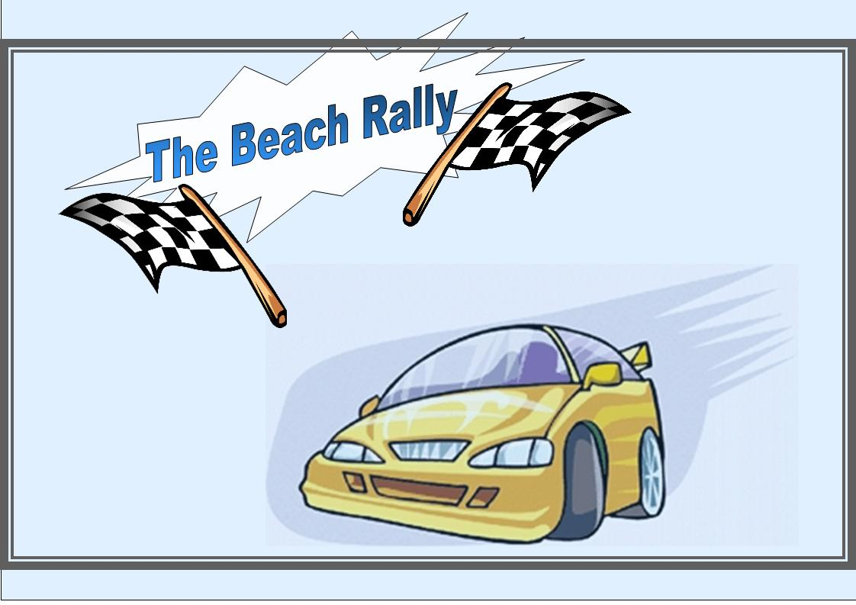
In the Racing Game of Knowledge
Who will finish first?
Click Here to Start

Slide 2

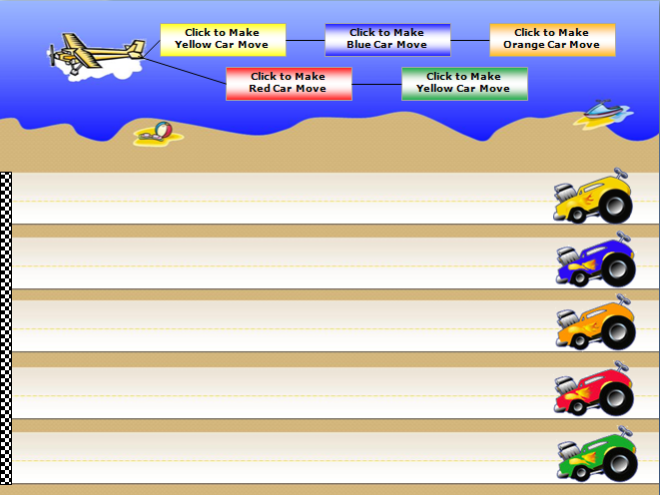
The Beach Rally
2
Instructions:
Divide into Teams.
Each team is asked a question. If they answer correctly, click their teams color button to move their car.
Five correct answers will cross the finish line and win the race.
3
Play

Slide 3
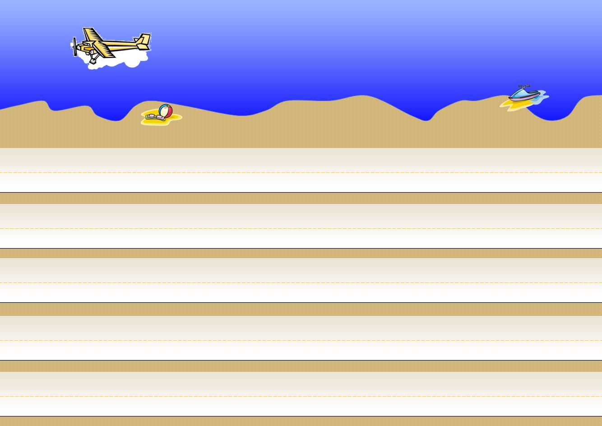





Click to Make
Yellow Car Move
Click to Make
Blue Car Move
Click to Make
Orange Car Move
Click to Make
Red Car Move
Click to Make
Green Car Move

Slide 4
The Beach Rally
© 2010 Jeff Ertzberger
All rights reserved.
All Clipart copyright GraphicsFactory.com– All Rights Reserved. Some images have been modified from original version.
This presentation may not be sold, or redistributed in any form without written permission of the author.
For even more template games and great resources visit:
uncw.edu/EdGames
By using this game you are agreeing to our terms of use.

