Slide 1
Align The Stars
Continue

Slide 2
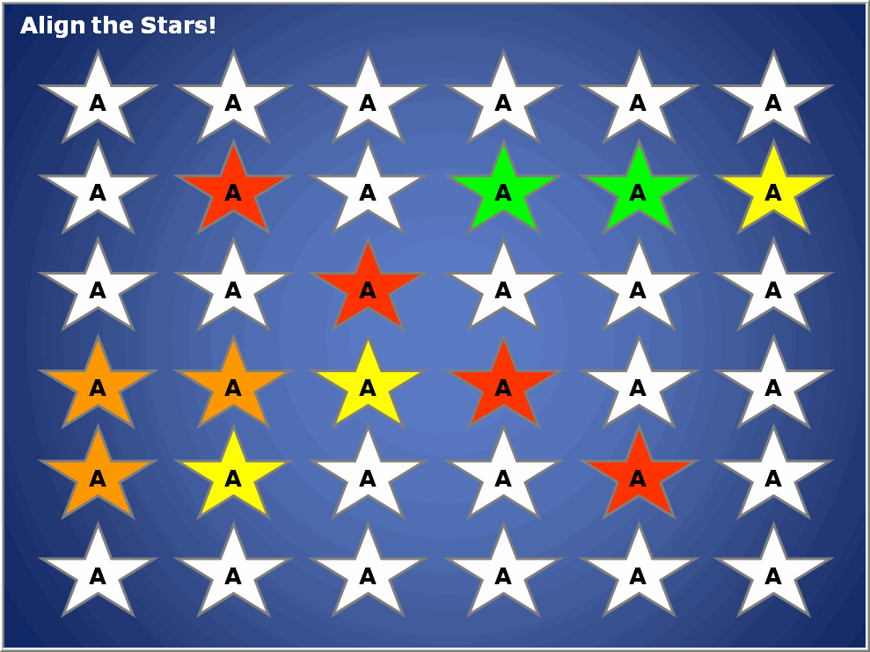
Be the First
To Align the Stars
Instructions:
Divide into Teams or use individuals. There can be up to Six teams. However play by more than three teams is not recommend, as it is very difficult to get four in a row with so many teams. The colors are: Red, Orange, Yellow, Green, Blue, and Purple.
Choose the number of stars required to win. Such as 3, 4, or 5 in a row.
Each team or individual is asked a question. If they answer correctly, the teacher will click the star until it changes to that teams color.
First team or individual to get the desired number of stars touching wins!
Stars can align in rows, columns, or diagonally.
Play

Slide 3
Align the Stars!
A
A
A
A
A
A
A
A
A
A
A
A
A
A
A
A
A
A
A
A
A
A
A
A
A
A
A
A
A
A
A
A
A
A
A
A
End Game - Start New Game

Slide 4
Align the Stars
© 2010 – Jeff Ertzberger All rights reserved.
All Clipart Copyright Graphics Factory.com– All Rights Reserved. Some images have been modified from original version.
This presentation may not be sold, or redistributed in any form without written permission of the author.
For even more template games and great resources visit:
uncw.edu/edgames
By using this game you are agreeing to our terms of use.

